Slide 1
Iceberg Tables
Iceberg tables are the brand new tables which has been made available as public preview for all accounts only recently. Now, these tables are powered by “Apache iceberg open table formats” and the idea is to store the data & metadata all within customer managed storage and being able to use the standard Snowflake features like execute the DMLs, encryption. Iceberg tables for Snowflake integrate your own external cloud storage with the query semantics and performance of standard Snowflake tables. They are perfect for data lakes that already exist and that you can’t or don’t want to store in Snowflake.
Efficient External Storage Management with Snowflake Iceberg-
The Iceberg table doesn't physically store the data within Snowflake itself. Instead, the data is stored in Parquet format within your designated cloud provider storage.
Snowflake Iceberg manages the metadata in the cloud bucket itself, separate from the actual data. This functionality extends to all major cloud providers, including AWS, Azure, and GCP.
For example, when using AWS, the data would be stored in an S3 bucket. When customers run queries against the Iceberg table, Snowflake translates the query and efficiently retrieves the data from your cloud storage, whether it's an S3 bucket, Azure Blob storage, or GCP Bucket.

Slide 2
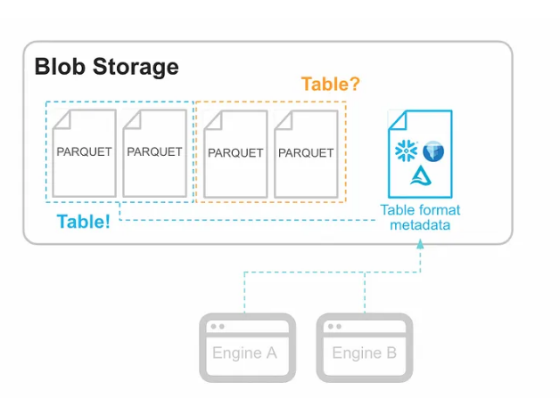
Table formats and why they matter
Diagram illustrates how Iceberg leverages external storage to manage large datasets efficiently. The separation of data and metadata, make Iceberg a powerful tool for data lake and data warehouse scenarios

Slide 3
 | Iceberg Tables | Native Tables
Metadata Format | Uses Iceberg Format, typically stored as JSON files. | Stored in Native Format (Foundation DB)
File Format | Data is stored in Parquet format only. | Supports multiple formats: JSON, AVRO, XML, PARQUET, ORC, CSV
Billing | Storage billed by the cloud provider. | Storage and usage billed by Snowflake.
Interoperability | High interoperability with parquet-supporting tools; seamless integration with various data processing frameworks. | Compatibility is dependent on Snowflake's support for various formats.
Storage | Data stored in Customer-Supplied Cloud Storage (e.g., AWS S3, Azure Blob, GCP). | Managed and stored within Snowflake's infrastructure.
Control
 | Open Source; provides more flexibility and control over storage location and management. | Less flexibility since Snowflake manages metadata and storage.
This table provides a high-level comparison of Snowflake Iceberg and native Snowflake tables

Slide 4
Here's how this benefits you as a customer:
Cost Optimization: Data storage usage is billed directly by your cloud storage provider, while your Snowflake account is billed for compute and cloud services usage.
Table Metadata in Iceberg Format: Store data in Parquet format, a widely adopted and efficient columnar storage format. Parquet's columnar storage and compression make it ideal for efficient data storage and processing.
Multi-Engine Compatibility: You desire Snowflake to handle table management tasks such as inserts, updates, and more, allowing queries within Snowflake
Performance without Compromise: Snowflake Iceberg maintains exceptional query performance similar to Snowflake tables, ensuring efficient data analysis
Unlock Discounts: Optimize Costs with Custom Storage Pricing: As a substantial cloud customer, you likely benefit from significant storage discounts owing to extensive datasets, often spanning petabytes
This approach can lead to even greater cost savings compared to storing data in Snowflake's native compressed tables, which typically incur a standard charge of $23 per compressed terabyte per month

Slide 5
Snowflake Iceberg Capabilities
Full DML support: Perform data manipulation operations (insert, update, delete) with no performance penalty compared to native Snowflake tables.
Advanced Features: Leverage features like multi-table transactions and dynamic data masking, ensuring data integrity and security.
Row-Level Security: Apply row-level security policies to control data access based on user roles or attributes, similar to native Snowflake tables.
External Data Utilization: Iceberg data stored in customer-managed storage can be accessed and utilized by external applications and tools outside the Snowflake environment.

Slide 6

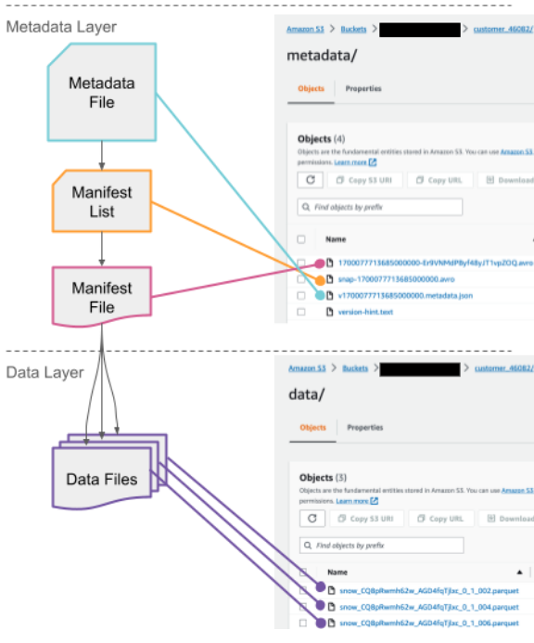
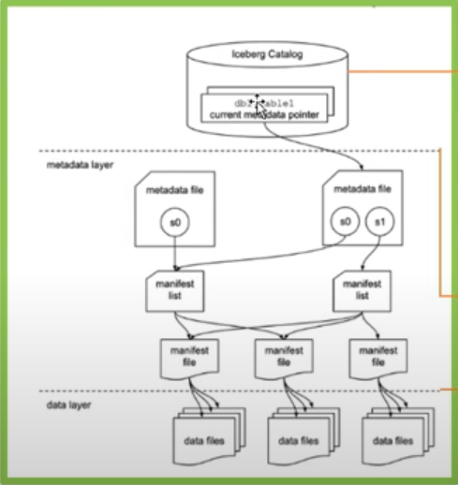

Slide 7

1 :Iceberg Catalog:
Catalog is responsible for storing and organizing metadata, enabling operations such as listing tables, creating or deleting tables, and tracking table versions
Use Snowflake as the Iceberg catalog:
An Iceberg table that uses Snowflake as the Iceberg catalog provides full Snowflake platform support with read and write access. The table data and metadata are stored in external cloud storage, which Snowflake accesses using an external volume.
Use an external catalog:
An Iceberg table that uses an external catalog provides limited Snowflake platform support with read-only access. With this table type, Snowflake uses a catalog integration to retrieve information about your Iceberg metadata and schema.
You can use this option to create an Iceberg table registered in the AWS Glue Data Catalog or to create a table from Iceberg metadata files in object storage.

Slide 8
2) Metadata Layer
Metadata Files: These files store critical information about the table, such as its schema, partitioning information, and snapshots. They also track the history of changes and the current state of the table.
Manifest Lists: These lists contain pointers to manifest files and include high-level statistics and partition information, enabling efficient data access and filtering.
Manifest Files: These files list individual data files along with their statistics, such as record counts and column bounds. They enable fine-grained tracking and management of data at the file level​.
3) Data Layer
Data Layer is the foundation of Iceberg tables, holding the actual data files. The data layer is optimized for efficient querying and data management, supporting operations like partitioning, which groups similar rows together to speed up queries.

Slide 9
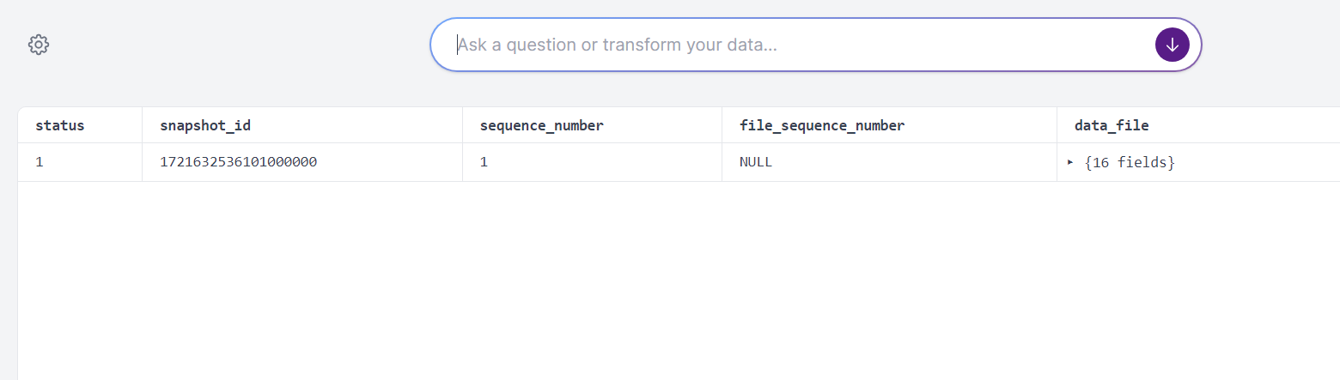
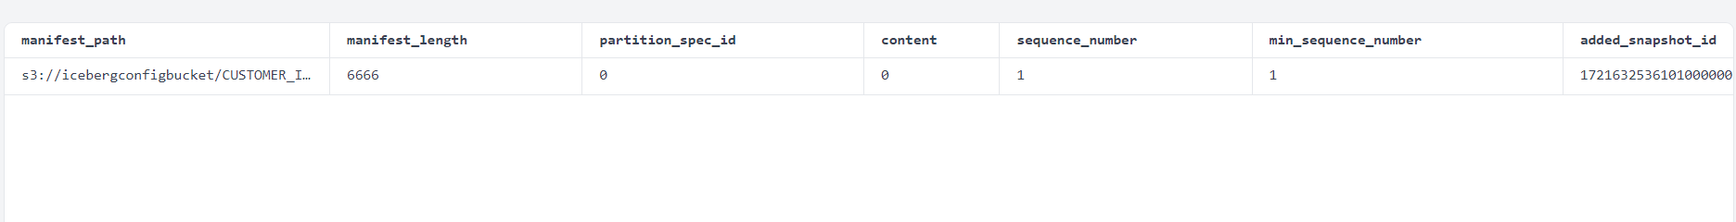
https://konbert.com/viewer/avro
1721632536101000000-5SBmD7P6jqwnf-a3Cj31ow.avro
Manifest file in Avro format that contains a list of data files present in the data folder
This file (1753548628877000000-...avro) is a manifest, which contains file-level metadata.
It tells Iceberg:
Where the actual data files are (e.g., Parquet/ORC files)
What partitions each file covers
The row count, min/max values, null counts per column
snap-1721632536101000000-723adc31-5973-44f0-a3a7-cc875010786b.avro
Manifest List file in Avro format that stores details about manifest files
Operation performed (e.g., append, overwrite)

Slide 10
Snowflake as the Iceberg catalog
Follow the below steps to create an external volume in Snowflake on Amazon S3
STEP-1: Create an S3 Bucket in the same region of your Snowflake Account
STEP-2: IAM policy that grants access to your S3 location
STEP-3: Create an IAM role
STEP-4: Create an External Volume in Snowflake
STEP-5: Retrieve the AWS IAM User for your Snowflake Account
STEP-6: Grant the IAM user Permissions to Access Bucket Objects

Slide 11
